Slide 1

jawaharlal nehru technological university anantapur ananthapuram-515002, india
Pre-Submission Seminar A NOVEL APPROACH FOR EFFICIENT HANDOFF MANAGEMENT IN HETEROGENEOUS NETWORKS
Research Scholar
Kiran Mannem
Regd. No: 15PH0421
Department of ECE
Co-Supervisor Supervisor
Dr.S.Chandra Mohan Reddy Dr. P.Nageswara Rao
Professor & HOD, Professor & HOD,
Department of ECE Department of ECE,
JNTUACE, Vardhaman College of Engineering, Anantapuramu. Hyderabad.

Slide 2
Course Work:
The course work was started in the month of June 2016 for one week dated from 13th June 2016 - 25th June 2016 on “Research Methodology and Intellectual Property Rights” by experts.
Guide Interaction Program:
The Guide Interaction program of one week dated from 29th Aug -3rd Sep 2016, was successfully completed and submitted Preliminary Report.
Selection of Subjects for Pre-Ph.D and Status
As per the instructions and guidance of the supervisor and Co supervisor, these are the selected subjects for Pre-PhD. From Part –I & II selected subjects are the following.
PART-I --- Digital Data Communications and Networks (09PH04101)(cleared)
PART-II --- Wireless Communications(09PH04201)(cleared)
Common Subject for all Research Scholars are
Research Methodology (11PH00001)(cleared)
Intellectual Property Rights(15PH00001)(cleared)

Slide 3
Previous RRMs -
RRM-14 :
The criteria for deciding the performance of the various handoff management schemes understood.
Types of handovers, handover mechanisms, comparison of 1G,2G,3G,and 4G handover schemes were presented.
date of RRM: 7th August 2017
Remarks given by the Committee : Asked to Compare the performance characteristics of various handoff mechanisms.
Action taken on the comments : approximately 30 research papers are collected on the topic and studied thoroughly
RRM-15 :
Literature survey done on comparison of handover schemes were presented.
Date : 8th January 2018
Comments given by the Committee members: Identify parameters and problem statement and asked to publish in SCI indexed journals
Action taken on the comments : Identified metrics in hand off management and proposal for one of the problem in load balancing
RRM-18 :
Handover Decision by Regression Heuristics of Quality Metrics (RHQM) for optimal load balancing in LTE & LTE-A Networks were presented.
Date : 16th September 2019
Comments given by the Committee members: complete the papers as early as possible and asked to publish in SCI indexed journals
Action taken on the comments: Completed one International conference paper and published in IEEE explorer in august 2020

Slide 4
Previous RRMs -
RRM-19 :
date of RRM: 17th October 2020
Remarks given by the Committee : The committee members suggested to provide the results on mobility management using KGMO algorithm.
Action taken on the comments :
High-Performance Mobility Management Using KGMO in Heterogeneous LTE Cellular Networks paper is under review in SCIE indexed journal with high impact factor
Two more papers are in progress
RRM-21 : (5th RRM for me)
Date : 29th October 2021
Remarks given by the Committee : The committee members suggested to modify the results on mobility management using KGMO algorithm.
Action taken on the comments :
High-Performance Mobility Management Using KGMO in Heterogeneous Networks paper is accepted in International Journal of Wireless and Mobile Computing. (INDERSCIENCE Publisher)Scopus indexed journal.
Completed one International conference paper titled
‘Multi-Objective_Artificial_Flora_Algorithm_Based_Optimal_Handover_Scheme_for_LTE-Advanced_Networks’ and published in IEEE explorer in January 2023.
RRM-26 : (6th RRM for me)
Date : 1st April 2023
Remarks given by the Committee: Results obtained to be analyzed and compared with recent works of literature.
Action taken on the comments : updated results and compared with contributed works.

Slide 5
Outline
Motivation
Objectives
Literature review
Introduction
RHQM
MOAF
KGMO
Conclusion of the work
Future Scope
Paper Publications
References

Slide 6
Motivation

Slide 7
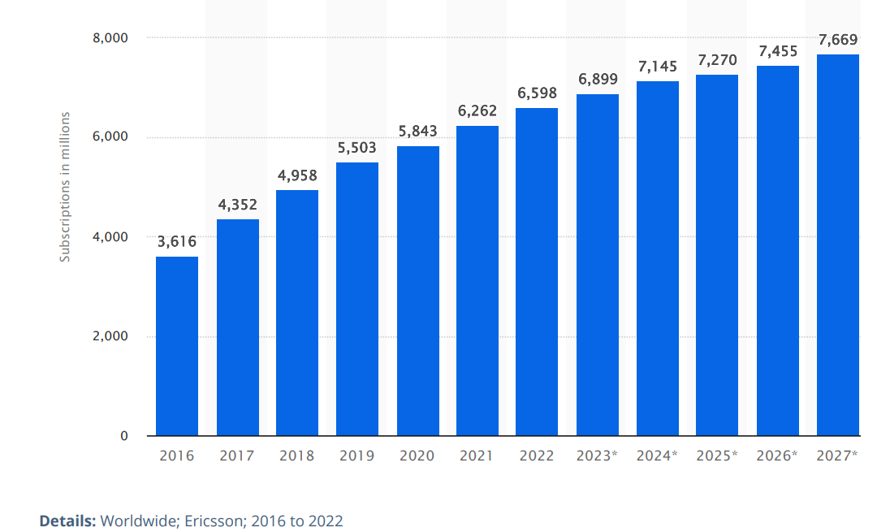
Subscribers growth in mobile communications
Since the mobile UE has become a part of daily life,
Mobile communications have expanded and demand has grown in areas
data traffic
speed.

Slide 8
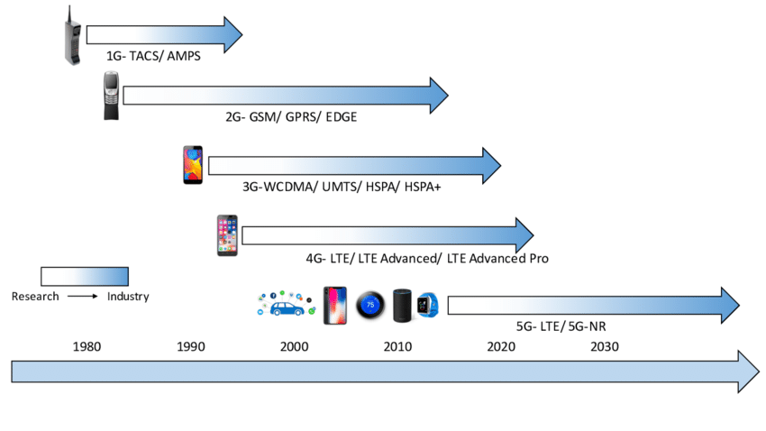
Evolution of from 1g to 5G
The demand, speed, capacity, coverage, and Quality of Services (QoS) cannot be satisfied by the 1G, 2G, and 3G networks .
The LTE (4G)has fulfilled the QoS, demand, speed, capacity and coverage.
As a result, the mobile communication sector switches to the next generation mobile networks (LTE/LTE-Advanced).
Liu, Liyuan & Han, Meng. (2019). Privacy and Security Issues in the 5G-Enabled Internet of Things. 10.1201/9780429199820-12.

Slide 9
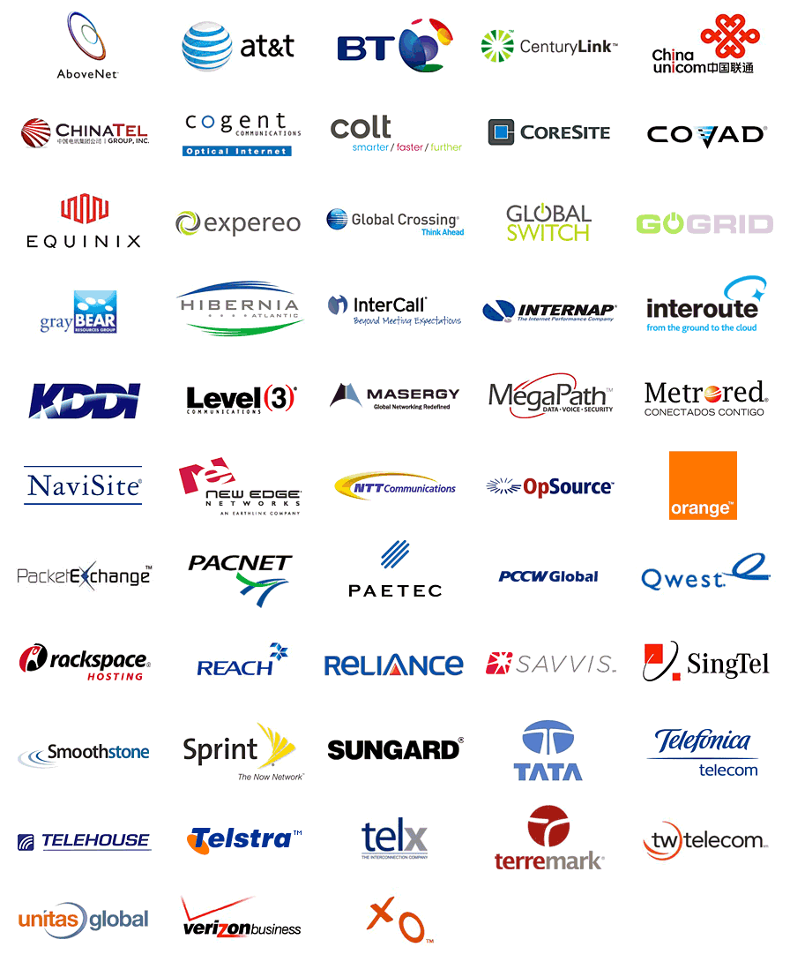

Global service providers
Telecom service providers are key drivers of technological advancement,
continually investing in research and development to improve network capabilities and introduce innovative services.
They play a vital role in
enabling digital transformation and facilitating the growth of various sectors,
e-commerce,
cloud computing,
IoT,
by providing the necessary connectivity and infrastructure for seamless communication and data transfer on a global scale.

Slide 10
NEED
Wireless communication faces several challenges,
interference,
fading,
limited bandwidth.
Also, Cellular networks has
Spectrum Congestion
Data Traffic Explosion
Network Capacity and Coverage
Backhaul and Infrastructure
Security and Privacy
LTE HetNets are a type of wireless network architecture that combines
different types of access points to provide increased network capacity and coverage.
It has also several challenges,
Interference Management,
Resource Allocation,
Backhaul Capacity,
Cell Selection
Handoff Management

Slide 11
Literature
References | Observations
Sen, Jaydip. "Mobility and handoff management in wireless networks." arXiv preprint arXiv:1011.1956 (2010). Goyal, Tanu, and Sakshi Kaushal. "Handover optimization scheme for LTE-Advance networks based on AHP-TOPSIS and Q-learning." Computer Communications 133 (2019): 67-76. Kalbkhani, Hashem, et al. "QoS-based multi-criteria handoff algorithm for femto-macro cellular networks." Wireless Personal Communications 98 (2018): 1435-1460. | Mobility and Handoff management fundamentals and issues discussed in the context of 4G to 5G. AHP-TOPSIS method used for selecting eNB by considering multiple parameters and compared with traditional methods But still optimization is not done for selecting eNB. In QMHA only three parameters are considered for HO issues for femto-macro cells. But not considered more metrics to get best connection.
Li, Yun, Bin Cao, and Chonggang Wang. "Handover schemes in heterogeneous LTE networks: challenges and opportunities." IEEE Wireless Communications 23, no. 2 (2016): 112-117. | LTE-AN employs small cells such as picocells and microcells to improve data rates and energy efficiency. The HO problem is more significant in LTE-AN because of dense cells.
Qiu, Yue, Maode Ma, and Xilei Wang. "A proxy signature-based handover authentication scheme for LTE wireless networks." Journal of Network and Computer Applications 83 (2017): 63-71. | The HO system for 4G-LTE wireless networks has become more complex because of numerous types of Base Stations. It is discovered that there is a lack of backward compatibility and security due to the use of key chains in the HO operations
Tayyab, Muhammad, Xavier Gelabert, and RikuJäntti. "A survey on handover management: From LTE to NR." IEEE Access 7 (2019): 118907-118930. | An ultra-densification technique has been introduced to compress the BS coverage and to enhance frequency repeatability in order to fulfil the enormous data demands. Still Number of HO s are more due to density of cells

Slide 12
Literature
References | Observations
Hussein, YaseeinSoubhi, Borhanuddin M. Ali, MohdFadlee A. Rasid, AduwatiSali, and Ali Mohammed Mansoor. "A novel cell-selection optimization handover for long-term evolution (LTE) macrocellusing fuzzy TOPSIS." Computer Communications 73 (2016): 22-33. Wu, Xuehan, et al. "A Multi-objective Artificial Flora Optimization Algorithm." Simulation Tools and Techniques: 11th International Conference, SIMUtools 2019, Chengdu, China, July 8–10, 2019, Proceedings 11. Springer International Publishing, 2019. | Fuzzy TOPSIS method used for Handover solutions But it did not address the optimal selection of eNB . MOAF used for multi objective optimization and compared with PSO. This can be used for multi objective criteria of any field as optimization solution.
Alhammadi, Abdulraqeb, et al. "Auto tuning self-optimization algorithm for mobility management in LTE-A and 5G HetNets." IEEE Access 8 (2019): 294-304. | In ATO algorithm is based on UE speed and RSRP Only. For a seamless connection, and eNB selection with multiple parameters to be considered to get optimum solutions.
Moein, Sara, and Rajasvaran Logeswaran. "KGMO: A swarm optimization algorithm based on the kinetic energy of gas molecules." Information Sciences 275 (2014): 127-144. | KGMO algorithm is proposed and compared with traditional PSO and GSA to solve optimization problems. KGMO algorithm would be able to improve the performance of most systems that require a solution to optimization problems.

Slide 13
Gaps
AHP-TOPSIS method used for selecting eNB by considering multiple parameters and compared with traditional methods
But still optimization is not done for selecting eNB.
In QMHA only three parameters are considered for HO issues for femto-macro cells.
But not considered more metrics to get best connection
LTE-A employs small cells such as picocells and microcells to improve data rates and energy efficiency.
The HO problem is more significant in LTE-A, because of dense cells

Slide 14
Gaps
One of the core criteria for ensuring Quality of Service (QoS) of the network is cell selection in Handoff management.
The User Equipment (UE) has a number of possibilities for transferring control to the following eNodeB(eNB) in order to maintain QoS on the network, but choosing the best eNB is the key difficulty that depends on the multiple quality factors.
Hence, the targeted eNB must be carefully chosen in order to tackle these problems.

Slide 15
Objectives
The main objective of this work is to select target cell under multi objective QoS metrics with minimal process complexity in LTE Heterogeneous network to perform handoff
by considering
distance
multiple quality metrics
coverage area
It is expected to yield best connection by optimizing performance metrics
Handover failure rate
Call drop ratio
Call block Ratio
Throughput

Slide 16
Small cells
Due to the rapid rise in the number of mobile subscribers, it is essential to boost cellular capacity.
Hence, Small cells are regarded as an emerging technology for boosting the potential capacity of cellular networks.
As the density of infrastructure increases, users have many choices for connection. (In the context of transition from 4G to 5G)
So, Efficient handoff mechanisms are essential for ensuring seamless connectivity and uninterrupted service delivery.

Slide 17

introduction
Wireless Communication network technology is one of the fastest growing and most dynamic sectors in the world.
Cellular communication is a type of wireless communication that uses a network of cells to provide coverage to a large geographical area.

Slide 18
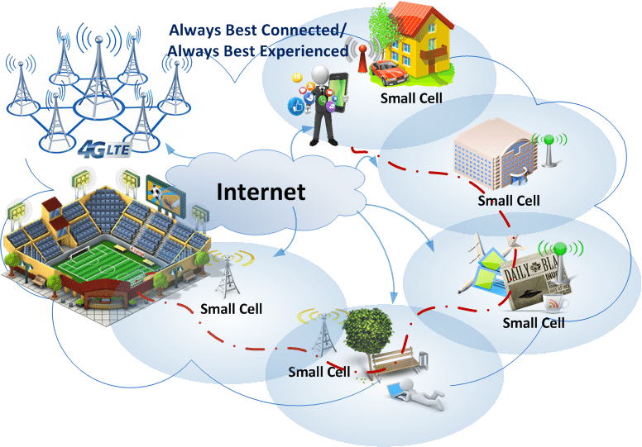
LTE HetNet
The main idea behind LTE HetNets is to deploy small cells, such as picocells and femtocells, in addition to traditional macrocells to provide coverage in areas with high demand or poor radio conditions.
Small cells are typically deployed in indoor or outdoor areas with high user density, such as shopping malls, train stations, or sports venues.
Trestian, Ramona & Vien, Quoc-Tuan & Shah, Purav & Mapp, Glenford. (2017). UEFA-M: Utility-based Energy Efficient Adaptive Multimedia Mechanism over LTE HetNet Small Cells. 10.1109/ISWCS.2017.8108149.

Slide 19
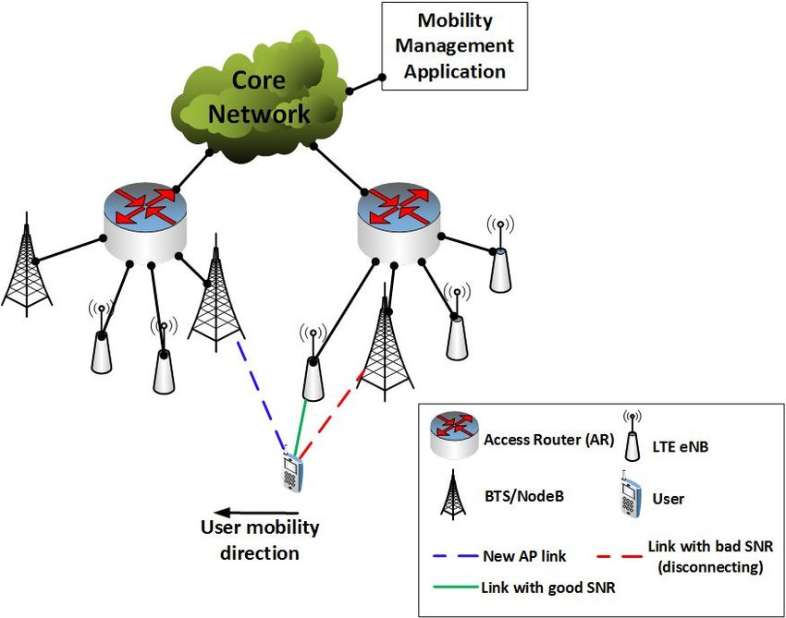
Mobility management
Mobility management is a main challenge in the evolving multiservice Heterogeneous network.
It consists of two components:
location management and Handoff management.
Location management tracks and locates the Mobile Terminal (MT) for successful information delivery.
Rony, Rakibul Islam & Jain, Akshay & Lopez-Aguilera, Elena & Garcia-Villegas, Eduard & Demirkol, Ilker. (2017). Joint Access-Backhaul Perspective on Mobility Management in 5G Networks. 10.1109/CSCN.2017.8088608.

Slide 20
Handoff management
Handoff management is the process by which a mobile node keeps its connection active when it moves from one access point to another.
Handoff process
Initialization
Connection management
Execution
Research Focus

Slide 21
contribution
The present research focuses on the selecting the ideal target cell for Handoff management in LTE HetNets.
The Regression Heuristics Quality Metrics (RHQM), Multi-Objective Artificial Flora (MOAF), and Kinetic Gas Molecular Optimization (KGMO) methods are used
By simulating the proposed methods and comparing them with existing models, the research evaluates their performance under different parameters, scaling their capabilities.
The findings aim to enhance the seamless connectivity and uninterrupted service delivery in LTE HetNets, addressing the complexities associated with managing Handoffs between different types of access nodes.

Slide 22
Optimization algorithms for Handoff connection management
Optimization algorithms
RHQM
KGMO
MOAF
Connecting to best network by selecting Target cell
Connecting to best network by applying KGMO algorithm
Selecting Target eNB by applying MOAF algorithm
Performance metrics compared with AHP-TOPSIS and QMHA
Performance metrics compared with PSO algorithm
Performance metrics compared with AHP-TOPSIS

Slide 23
1 Target cell selection using RHQM
1
Objective: connecting to best network using regression heuristic and minimum fitness value of Target cells(TC) in the list.
There are nine quality metrics for TC selection.
Regression Heuristics of each metric is estimated
it returns the regression heuristic, respective lower and upper bounds.
The carrier that initiating the handover process allocates
A rank for each neighbour cell, such that each target cell ranked as 1, 2, 3, or 0 for each quality metric adapted.
In this regard each target cell entails divergent ranks for divergent metrics under the expected metric value of the triggered time interval.

Slide 24
1 Ranking of each Target cell in RHQM
For each target cell
if the expected value of a metric is lesser than the regression heuristic that indicates the lower bound of the metric values, then ranks as 0,
if the expected value of metric is equal to the regression heuristic, then assigns rank 1,
if greater than the regression heuristic, and lesser than the upper bound of the metric value, then assigns rank 2,
or if the expected metric value is greater than the upper bound of the metric value, then rank the target cell as 3for the corresponding metric.
Fitness function is also estimated for each ranked target cells.
The target cells has to be sorted in ascending order of the metrics.
Further selects the target cells in ascending order of their fitness value.

Slide 25
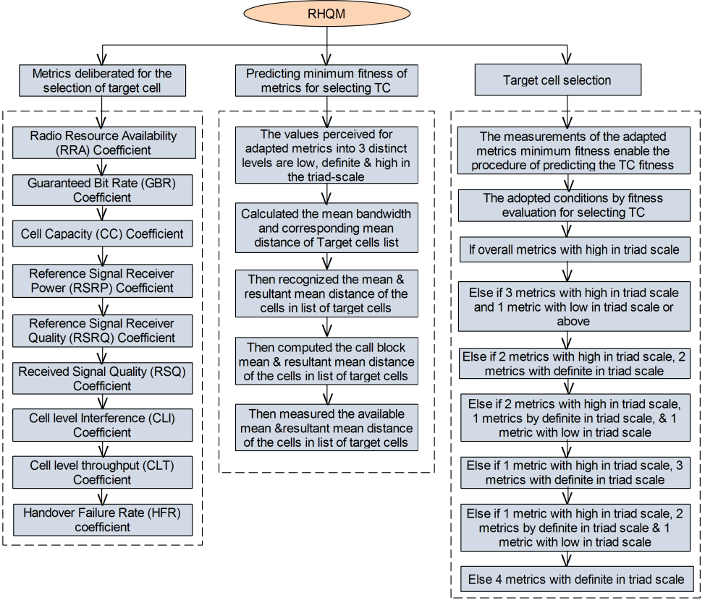

Slide 26
Formulae used

Slide 27
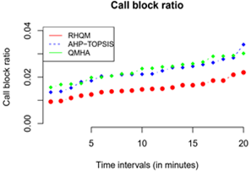
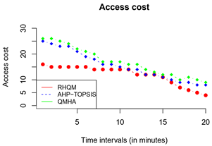
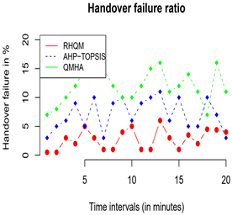
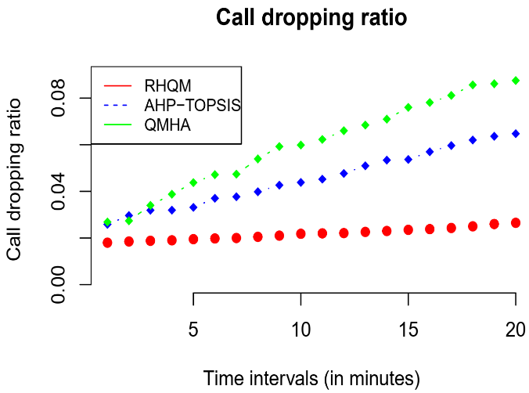
performance parameters compared with ahp-topsis&qmha

Slide 28
published
Mannem, Kiran, P. Nageswara Rao, and S. Chandra Mohan Reddy. "Handover Decision in LTE & LTE-A based hetnets using regression heuristics of quality metrics (RHQM) for optimal load balancing." 2020 Fourth International Conference on Inventive Systems and Control (ICISC). IEEE, 2020. https://doi.org/10.1109/ICISC47916.2020.9171206

Slide 29
Multi-Objective Artificial Flora (MOAF) Algorithm
2
Objective: To select target cell under multi objective QoS metrics with minimal process complexity to perform handover process.
As an objective function for selecting the best eNB,
uplink Signal to Interference Plus Noise ratio (SINR),
Reference Signal Received Quality (RSRQ),
Reference Signal Received Power (RSRP),
fading factor
The target eNB is chosen using fitness function is taken into account as an objective function.
The effectiveness of this method is assessed
Hand Off Failure (HOF),
Hand Off Ping Pong (HOPP),
Call Blocking Ratio (CBR),
Call Dropping Ratio (CDR)

Slide 30
Selection of the target eNB using MOAF
As a first step,
all eNBs are initialized and calculated the distances among users and eNBs.
Second step,
preparation of the target eNBs ,calculate the fitness function based on metrics and survival probability.
Third step,
select the target eNB and user switches from serving to target eNB.

Slide 31
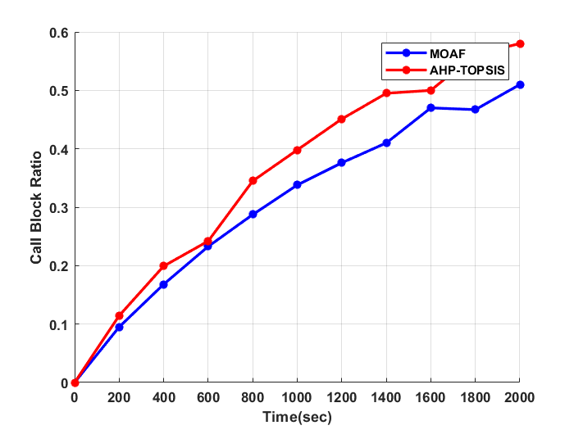
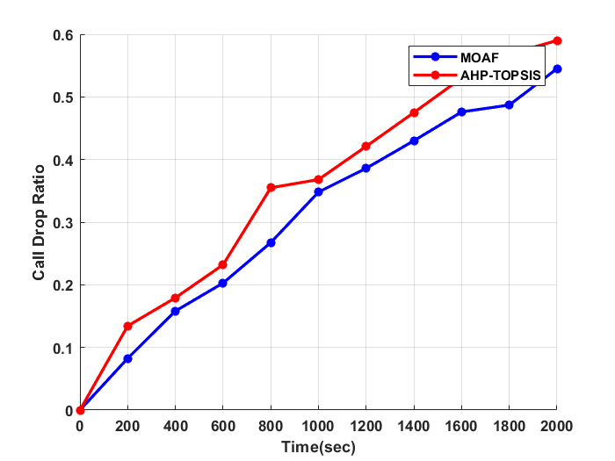
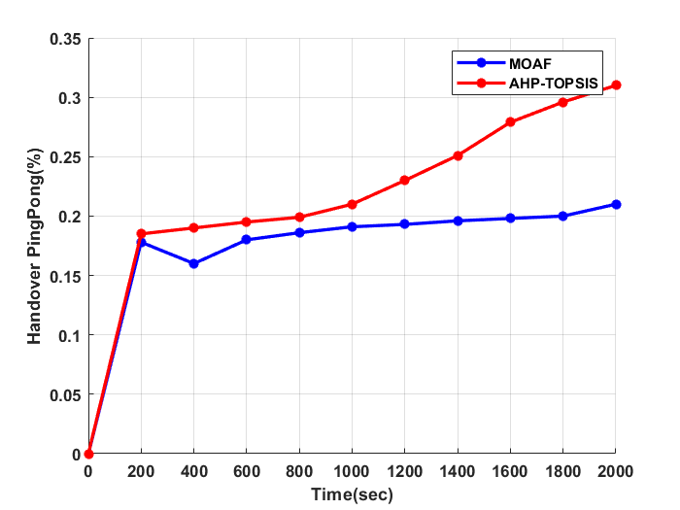
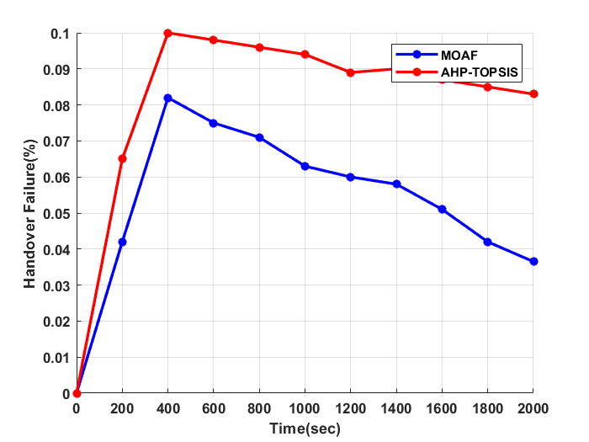
performance parameters compared with ahp-topsis

Slide 32
published
Mannem, Kiran, Pasumarthy Nageswara Rao, and S. Chandra Mohan Reddy. "Multi-Objective Artificial Flora Algorithm Based Optimal Handover Scheme for LTE-Advanced Networks." 2022 6th International Conference on Electronics, Communication and Aerospace Technology. IEEE,2022. https://doi.org/10.1109/ICECA55336.2022.10009271

Slide 33
KGMO optimization in Heterogeneous networks
3
The KGMO optimization technique is used to make decisions
Distance,
Velocity,
Coverage area
It is aimed to improve performance metrics
Throughput,
Over all Delay,
Number of Hand overs.
Call drop ratio
Call block ratio

Slide 34
KGMO optimization in Heterogeneous networks
Performance metrics are evaluated based
Number of users
Cluster Heads.
The KGMO is compared with PSO methodologies for evaluating these performance metrics.

Slide 35
Mobility Management using KGMO Optimization process
Initially all
the user parameters are read from the network
user data is pre-processed before it is given for the optimization engine.
Then the kinetic energy is initialized for every user.
The initial fitness function is estimated
The best fitness is arrived after it undergoes number of iterations.
The number of iterations depends on time.
Upon arriving the best fitness function,
If not, again it will go to pre-processing
If yes, the device will be connected to best network and process stops.

Slide 36
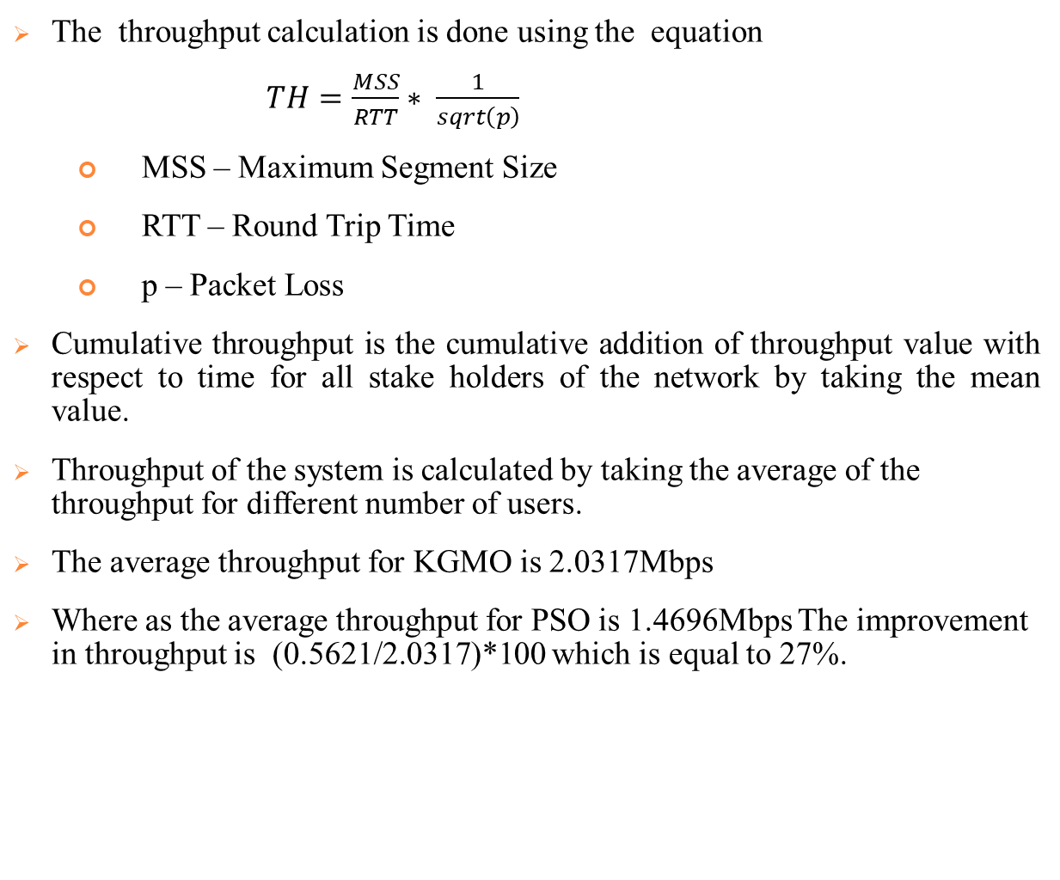
Calculation of performance metrics
The throughput calculation is done using the equation
$TH=\frac{MSS}{RTT}∗ \frac{1}{sqrt\left(p\right)}$
MSS – Maximum Segment Size
RTT – Round Trip Time
p – Packet Loss
Cumulative throughput is the cumulative addition of throughput value with respect to time for all stake holders of the network by taking the mean value.
Throughput of the system is calculated by taking the average of the throughput for different number of users.
The average throughput for KGMO is 2.0317Mbps
Where as the average throughput for PSO is 1.4696Mbps The improvement in throughput is (0.5621/2.0317)*100 which is equal to 27%.

Slide 37
performance parameters compared with PSO

Slide 38
published
Mannem, K., Rao, P.N. and Reddy, S.C.M. (2023) ‘High-performance mobility management using KGMO in heterogeneous network’, Int. J. Wireless and Mobile Computing, Vol. 24, Nos. 3/4, pp.235–242. https://doi.org/10.1504/IJWMC.2023.131308

Slide 39
Comparison table
Method
 | RHQM |  |  | MOAF |  | KGMO |  | REMARKS
 | AHP TOPSIS | QMHA | RHQM | AHP TOPSIS | MOAF | PS0 | KGMO | Selection time
HFR(%) | 2.80 | 6.80 | 0.50 | 0.10 | 0.08 | 0.08 | 0.06 | 400ms
 | 10 | 7.30 | 2.30 | 0.08 | 0.03 | 0.05 | 0.04 | 2000ms
CDR(%) | 2.40 | 2.74 | 1.80 | 0.17 | 0.15 | 0.18 | 0.16 | 400ms
 | 3.10 | 3.60 | 1.90 | 0.59 | 0.54 | 0.34 | 0.26 | 2000ms
CBR(%) | 1.20 | 1.50 | 0.90 | 0.20 | 0.17 | 0.20 | 0.17 | 400ms
 | 1.60 | 1.70 | 1.50 | 0.58 | 0.51 | 0.59 | 0.45 | 2000ms
Throughput(Mbps) | 0.77 | 1.17 | 1.23 | 0.82 | 1.12 | 4.67 | 7.58 | 20s
 | 0.75 | 1.13 | 1.20 | 1.10 | 1.40 | 5.6 | 7.60 | 100s
Metrics

Slide 40

Simulation tool used Vienna_LTEA_SLS_v2.0_Q3_2018

Slide 41
Conclusion
Throughput:
The KGMO method demonstrates the highest throughput values at both 400ms (7.58 Mbps) and 2000ms (7.60 Mbps).
PSO also exhibits high throughput values, with 4.67 Mbps at 400ms and 5.6 Mbps at 2000ms.
RHQM and MOAF show moderate throughput values.
QMHA and AHP-TOPSIS exhibit relatively lower throughput values.
Call Block Rate (CBR):
KGMO shows the lowest CBR values at both 400ms (0.17%) and 2000ms (0.45%).
PSO and MOAF also demonstrate low CBR values.
AHP-TOPSIS, QMHA and RHQM exhibit higher CBR values.

Slide 42
Conclusion continued
Handover Failure Rate (HFR):
KGMO shows the lowest values for HFR, suggesting effective handling of handover processes. These methods demonstrate a high success rate in maintaining active calls during handovers
MOAF and PSO also demonstrate low HFR values.
AHP-TOPSIS, QMHA, and RHQM exhibit higher HFR values.
Call Drop Rate (CDR):
KGMO exhibits the lowest CDR values at both 400ms (0.16%) and 2000ms (0.26%).
MOAF and PSO show relatively low CDR values.
AHP-TOPSIS, QMHA, and RHQM demonstrate higher CDR values.
Based on these observations, the novel approach KGMO consistently performs well across all four parameters and different times, showing the highest throughput values, low HFR, low CDR, and low CBR. Therefore, the KGMO method can be considered the best method among all methods.

Slide 43
Final Conclusion
Based on these conclusions, KGMO emerges as a strong contender with excellent network performance in terms of throughput and satisfactory handoff performance with low HFR and CDR.
MOAF also demonstrates promising handoff performance with low HFR and CDR, but its network performance in terms of throughput is relatively lower.
Therefore, KGMO appears to be a favourable option considering both network and handoff performance factors.
 | Handoff performance | Network performance
KGMO | √ | √
MOAF | √ | —
RHQM | — | —

Slide 44
Future Scope
It is recommended to conduct more study on handoff-margins tuning and to employ regression coefficients as fitness scales in genetic algorithms and differential evolution methods.
This work can be extended by using a hybrid optimization technique to reduce the calculation time.
Proper deep learning techniques can be applied to the data to perform a highly accurate decision-making process in less time.
This can improve overall network performance.

Slide 45
LIST OF PUBLICATIONS
Mannem, Kiran, P. Nageswara Rao, and S. Chandra Mohan Reddy. "Handover Decision in LTE & LTE-A based hetnets using regression heuristics of quality metrics (RHQM) for optimal load balancing." 2020 Fourth International Conference on Inventive Systems and Control (ICISC). IEEE, 2020. https://doi.org/10.1109/ICISC47916.2020.9171206
Mannem, Kiran, Pasumarthy Nageswara Rao, and S. Chandra Mohan Reddy. "Multi-Objective Artificial Flora Algorithm Based Optimal Handover Scheme for LTE-Advanced Networks." 2022 6th International Conference on Electronics, Communication and Aerospace Technology. IEEE,2022. https://doi.org/10.1109/ICECA55336.2022.10009271
Mannem, K., Rao, P.N. and Reddy, S.C.M. (2023) ‘High-performance mobility management using KGMO in heterogeneous network’, Int. J. Wireless and Mobile Computing, Vol. 24, Nos. 3/4, pp.235–242. https://doi.org/10.1504/IJWMC.2023.131308

Slide 46
References
Ahmad, Rami, Elankovan A. Sundararajan, Nor E. Othman, and Mahamod Ismail. "Handover in LTE-advanced wireless networks: state of art and survey of decision algorithm." Telecommunication Systems 66, no. 3 (2017): 533-558.
Marabissi, D., Bartoli, G., Fantacci, R., Pucci, M.: An optimized CoMP transmission for a heterogeneous network using eICIC approach. IEEE Trans. Veh. Technol. 65(10), 8230–8239 (2016)
Li, Yun, Bin Cao, and Chonggang Wang. "Handover schemes in heterogeneous LTE networks: challenges and opportunities." IEEE Wireless Communications 23, no. 2 (2016): 112-117.
Sen, Jaydip. "Mobility and handoff management in wireless networks." arXiv preprint arXiv:1011.1956 (2010).
Samal, S.R., Bandopadhaya, S., Swain, K. and Poulkov, V., 2021. Mobility Management in Heterogeneous Cellular Networks. Journal of Mobile Multimedia, pp.407-426.
Bahra, N. and Pierre, S., 2021, June. A Hybrid User Mobility Prediction Approach for Handover Management in Mobile Networks. In Telecom (Vol. 2, No. 2, pp. 199-212). Multidisciplinary Digital Publishing Institute.
Qiu, Yue, Maode Ma, and Xilei Wang. "A proxy signature-based handover authentication scheme for LTE wireless networks." Journal of Network and Computer Applications 83 (2017): 63-71.
Tayyab, Muhammad, Xavier Gelabert, and RikuJäntti. "A survey on handover management: From LTE to NR." IEEE Access 7 (2019): 118907-118930.
Pokhrel, K., Dutta, N., Ghose, M.K. and Sarma, H.K.D., 2020. Performance analysis of various mobility management protocols for IPv6 based networks. International Journal of Computer Networks and Applications., 7(3), pp.62-81.
Su, Dongming, et al. "A self-optimizing mobility management scheme based on cell ID information in high velocity environment." 2010 Second International Conference on Computer and Network Technology. IEEE, 2010.

Slide 47
References
Komine, Toshihiko, Toshiaki Yamamoto, and Satoshi Konishi. "A proposal of cell selection algorithm for LTE handover optimization." 2012 IEEE Symposium on Computers and Communications (ISCC). IEEE, 2012.
Qian, Cen, Sihai Zhang, and Wuyang Zhou. "A novel cell selection strategy with load balancing for both idle and RRC-connected users in 3GPP LTE network." 2012 International Conference on Wireless Communications and Signal Processing (WCSP). IEEE, 2012.
Amzallag, David, et al. "Cell selection in 4G cellular networks." IEEE Transactions on mobile computing 12.7 (2013): 1443-1455.
Kamal, Archana, and Vineetha Mathai. "A novel cell selection method for LTE HetNet." 2014 International Conference on Communication and Signal Processing. IEEE, 2014.
Wang, Jun, et al. "Optimized fairness cell selection for 3GPP LTE-A macro-pico HetNets." 2011 IEEE vehicular technology conference (VTC Fall). IEEE, 2011.
Gao, Yuan, et al. "Performance of dynamic CoMP cell selection in 3GPP LTE system level simulation." 2011 IEEE 3rd International Conference on Communication Software and Networks. IEEE, 2011.
Zhu, Pengcheng, Lan Tang, and Bin Sheng. "Minimum SINR based dynamic cell selection scheme for LTE-advanced CoMP systems." Future Wireless Networks and Information Systems. Springer, Berlin, Heidelberg, 2012. 127-134.
Feng, Minghai, et al. "Enhanced dynamic cell selection with muting scheme for DL CoMP in LTE-A." 2010 IEEE 71st Vehicular Technology Conference. IEEE, 2010.
Hussein, Yaseein Soubhi, et al. "A novel cell-selection optimization handover for long-term evolution (LTE) macrocellusing fuzzy TOPSIS." Computer Communications 73 (2016): 22-33.
Goyal, Tanu, and Sakshi Kaushal. "Handover optimization scheme for LTE-Advance networks based on AHP-TOPSIS and Q-learning." Computer Communications 133 (2019): 67-76.

Slide 48
References
Girma, Solomon T., and Abinet G. Abebe. "Mobility load balancing in cellular system with multicriteria handoff algorithm." Advances in Fuzzy Systems 2017 (2017).
Kalbkhani, Hashem, et al. "QoS-Based Multi-criteria Handoff Algorithm for Femto-Macro Cellular Networks." Wireless Personal Communications 98.1 (2018): 1435-1460.
Mamman, M., 2021. Call admission control algorithm with efficient handoff for both 4G and 5G networks. International Journal of Wireless & Mobile Networks (IJWMN) Vol, 13.
Lee, Chung-Nan, Jun-Hong Lin, Chih-Feng Wu, Ming-Feng Lee, and Fu-Ming Yeh. "A dynamic CRE and ABS scheme for enhancing network capacity in LTE-advanced heterogeneous networks." Wireless Networks 25, no. 6 (2019): 3307-3322.
Ramos-Cantor, Oscar D., JakobBelschner, GanapatiHegde, and Marius Pesavento. "Centralized coordinated scheduling in LTE-Advanced networks." EURASIP Journal on Wireless communications and Networking 2017, no. 1 (2017): 1-14.
Srikantamurthy, S.H. and Baumgartner, A., 2021, October. A Novel Unified Handover Algorithm for LTE-A. In 2021 17th International Conference on Network and Service Management (CNSM) (pp. 407-411). IEEE.
Manoj and Kumar, S., 2022. A proposed cell selection and handover optimization using TAOWOA in self-organized LTE networks. Journal of Interdisciplinary Mathematics, pp.1-20.
A. Slalmi, H. Chaibi, R. Saadane, A. Chehri, and G. Jeon, “5G NB-IoT: Efficient network call admission control in cellular networks,” Concurr. Comput. Pract. Exp., no. July, pp. 1–12, 2020, doi: 10.1002/cpe.6047.
Ye, J. and Zhang, Y.J.A., 2019. DRAG: Deep reinforcement learning based base station activation in heterogeneous networks. IEEE Transactions on Mobile Computing, 19(9), pp.2076-2087.
Purushothaman, K.E. and Nagarajan, V., 2021. Multiobjective optimization based on self‐organizing Particle Swarm Optimization algorithm for massive MIMO 5G wireless network. International Journal of Communication Systems, 34(4), p.e4725.

Slide 49
References
Gong, W., Pang, L., Wang, J. and Xia, M., 2019. PSO-based resource allocation in software-defined heterogeneous cellular networks. KSII Transactions on Internet and Information Systems (TIIS), 13(5), pp.2243-2257.
Wu, Xuehan, et al. "A Multi-objective Artificial Flora Optimization Algorithm." Simulation Tools and Techniques: 11th International Conference, SIMUtools 2019, Chengdu, China, July 8–10, 2019, Proceedings 11. Springer International Publishing, 2019.
Alhammadi, Abdulraqeb, et al. "Auto tuning self-optimization algorithm for mobility management in LTE-A and 5G HetNets." IEEE Access 8 (2019): 294-304.
Moein, Sara, and Rajasvaran Logeswaran. "KGMO: A swarm optimization algorithm based on the kinetic energy of gas molecules." Information Sciences 275 (2014): 127-144.
Rupp, Markus, Stefan Schwarz, and Martin Taranetz. "The Vienna LTE-advanced simulators." https://link. springer. com/book/10.1007% 2F978-981-10-0617-3 (2016).
Afroz, Farhana, et al. "SINR, RSRP, RSSI and RSRQ measurements in long term evolution networks." International Journal of Wireless & Mobile Networks (2015).
Lee, Changsung, Sungjin Shin, and Jong-Moon Chung. "Enhanced LTE handover scheme using NFV for LTE handover delay reduction." 2016 IEEE International Conference on Consumer Electronics-Asia (ICCE-Asia). IEEE, 2016.
Tanner, Roope. "Handover performance evaluation between 450 MHz and 2600 MHz LTE networks." (2016).
Soret B, Mogensen P, Pedersen KI, Aguayo-Torres MC. Fundamental tradeoffs among reliability, latency and throughput in cellular networks. In2014 IEEE Globecom Workshops (GC Wkshps) 2014 Dec 8 (pp. 1391-1396). IEEE

Slide 50
THANK YOU

Slide 51
Title
"Optimizing Handoff Management in LTE HetNets: A Simulation-Based Evaluation of Regression Heuristics Quality Metrics, Multi-Objective Artificial Flora, and Kinetic Gas Molecular Optimization"
"Enhancing Seamless Connectivity in LTE HetNets: Target Cell Selection and Handoff Management using Regression Heuristics Quality Metrics, Multi-Objective Artificial Flora, and Kinetic Gas Molecular Optimization"
"Optimizing Target Cell Selection for Seamless Handoff Management in LTE HetNets"
"Intelligent Target Cell Selection for Seamless Handoff Management in LTE HetNets: A Comparative Study of Optimization Techniques"
"Enhancing Connectivity in LTE HetNets: Novel Approaches for Efficient Target Cell Selection and Handoff Management"
"Dynamic Target Cell Selection for Seamless Handoff Management in LTE HetNets: An Adaptive Approach"
"Optimizing Handoff Performance in LTE HetNets: Novel Strategies for Target Cell Selection and Management"

Slide 52
Title
"Optimizing Handoff Management in LTE HetNets using Regression Heuristics and Multi-Objective Artificial Flora Algorithms"
"Enhancing Seamless Connectivity in LTE HetNets through Target Cell Selection and Kinetic Gas Molecular Optimization"
"Performance Evaluation of Handoff Management Techniques in LTE HetNets using Regression Heuristics Quality Metrics and Multi-Objective Artificial Flora Algorithm"
"Efficient Handoff Management for Seamless Connectivity in LTE HetNets: A Comparative Analysis of RHQM, MOAF, and KGMO Approaches"
"Improving Network Performance in LTE HetNets: Target Cell Selection and Handoff Management using RHQM, MOAF and KGMO Algorithms"
"Comparative Analysis of Regression Heuristics, Multi-Objective Artificial Flora, and Kinetic Gas Molecular Optimization for Efficient Handoff Management in LTE HetNets"

Slide 53
Profile
https://ieeexplore.ieee.org/document/10009271
https://ieeexplore.ieee.org/document/9171206
https://www.inderscience.com/info/inarticle.php?artid=131308
https://www.scopus.com/authid/detail.uri?authorId=57219120080
https://vidwan.inflibnet.ac.in/profile/345660

